Slide 1
Timing Multiple Tasks
Jeffrey McDaniel

Slide 2
Utilization for Multiple Tasks
Embedded systems are arely designed with just one task, or State Machine.
Imagine you had the following State Machines
BlinkLED:
Assembly Instructions (Worst Case): 3 instr
Period: 500 ms
ThreeLEDs:
Assembly instructions (Worst Case): 9 instr
Period: 500 ms
And a microcontroller (M) which executes 100 instr / sec
Notes:
Let the students solve this

Slide 3
Utilization for Multiple Tasks
Microcontroller (M) executes 100 instr / sec
=> 0.010 sec / instr
1st calculate the WCET for each task
BlinkLED:
WCET: 3 instr * (sec / instr)
3 instr * (0.010 sec / instr)
30 ms
Period: 500 ms
ThreeLEDs
WCET: 9 instr * (sec/instr)
9 instr * (0.010 sec / instr)
90 ms
Period: 500 ms

Slide 4
Utilization for Multiple Tasks
2nd calculate the utilization for each task
BlinkLED:
WCET: 30 ms
Period: 500 ms
Utilization = WCET / Period
30 / 500
6%
ThreeLEDs:
WCET: 90 ms
Period: 500 ms
Utilization = WCET / Period
90 / 500
18%

Slide 5
Utilization for Multiple Tasks
3rd calculate the utilization for the system
BlinkLED:
WCET: 30 ms
Period: 500 ms
Utilization: 6%
ThreeLEDs
WCET: 90 ms
Period: 500 ms
Utilization: 18%
Utilization = BlinkLED utilization + ThreeLEDs utilization
6% + 18% = 24%

Slide 6
Utilization for Multiple Tasks
3rd calculate the utilization for the system
BlinkLED:
WCET: 30 ms
Period: 500 ms
ThreeLEDs
WCET: 90 ms
Period: 500 ms
Utilization = SUM(WCET) / Period
(30 ms + 90 ms) / 500 ms
(120 ms) / 500 ms = 24%

Slide 7
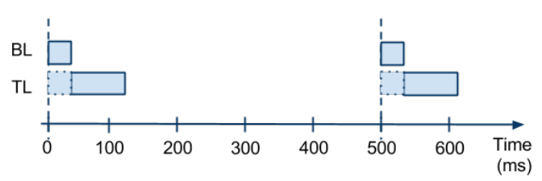
Timing Diagram

Slide 8
Now imagine the SMs get more complicated...
BlinkLED
WCET: 30 ms => 250 ms
Period: 500 ms
ThreeLEDs
WCET: 90 ms => 300 ms
Period 500 ms

Slide 9

What is the Utilization now?
BlinkLED
WCET: 250 ms
Period: 500 ms
ThreeLEDs
WCET: 300 ms
Period 500 ms
Utilization = SUM(WCET) / Period
SUM(BlinkLED.WCET, ThreeLEDs.WCET) / 500 ms
(250 ms + 300 ms) / 500 ms
550 ms / 500 ms
110%
Notes:
Let the students solve this on their own.
https://youtu.be/drShIDEX74Q

Slide 10
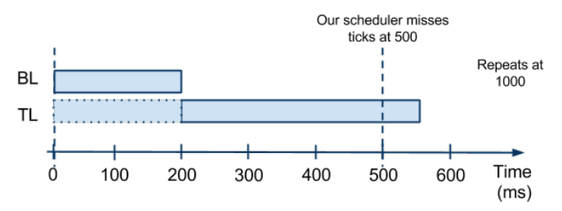
Timing Diagram
AT 500 ms TL is still executing so BL and TL both are unable to tick again

Slide 11
How do we decrease utilization?
Lengthen the SM periods
Reduce the SM execution time
Decrease the SM actions
Optimize the code
Speeding up the microcontroller
Removing an SM entirely

Slide 12
Recall the timing diagrams we’ve seen thus far

Slide 13
Timing Diagram

Slide 14
Timing Diagram

Slide 15
Notice a pattern?
Notes:
Do they?

Slide 16
Timing Diagrams
You could draw a timing diagram that shows the time out to infinity
How do you know when to stop? Or when you’ve drawn enough?
The least common multiple of the periods of multiple tasks is known as the Hyperperiod.

Slide 17
Hyperperiod
Assume you have the following State Machines:
BlinkLED
WCET: 30 ms
Period: 300 ms
ThreeLEDs:
WCET: 90 ms
Period: 200 ms
What is the hyperperiod?
Hyperperiod = LCM(200,300)
600 ms
Notes:
Allow the students to calculate it

Slide 18
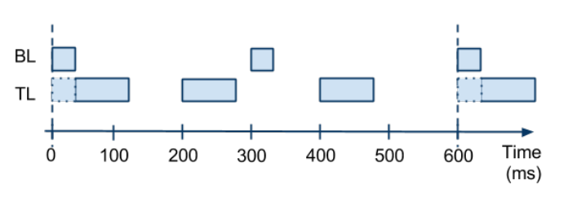
Timing Diagram

Slide 19
How is this useful?

Slide 20
Calculating the utilization
BlinkLED
WCET: 30 ms
Period: 300 ms
Utilization = 30 ms / 300 ms = 10%
ThreeLEDs
WCET: 90 ms
Period: 200 ms
Utilization = 90 ms / 200 ms = 45%
What is the system utilization?
Notes:
Let the students puzzle through this question

Slide 21
Calculating the utilization
BlinkLED
WCET: 30 ms
Period: 300 ms
Utilization = 30 ms / 300 ms = 10%
ThreeLEDs
WCET: 90 ms
Period: 200 ms
Utilization = 90 ms / 200 ms = 45%
Recall: Utilization = SUM(WCET) / period
However, BlinkLED and ThreeLEDs don’t share the same period, so what timeframe should we look at?
Notes:
Let the students puzzle through this question

Slide 22
Calculating the utilization
BlinkLED
WCET: 30 ms
Period: 300 ms
Utilization = 30 ms / 300 ms = 10%
ThreeLEDs
WCET: 90 ms
Period: 200 ms
Utilization = 90 ms / 200 ms = 45%
Use the hyperperiod
Utilization = SUM(WCET) / Hyperperiod
Notes:
Let the students puzzle through this question

Slide 23
Calculating the utilization
BlinkLED
WCET: 30 ms
Period: 300 ms
Executions: (Hyperperiod / period) = (600 / 300) = 2
ThreeLEDs
WCET: 90 ms
Period: 200 ms
Executions: (Hyperperiod / period) = (600 / 200) = 3
Utilization = SUM(WCET*executions) / hyperperiod
((2*30) + (3*90)) / 600
(60 + 270) / 600
(330) / 600 = 55%
Notes:
Let the students puzzle through this question

Slide 24
Calculating utilization for any number of tasks
Imagine you have (t₁, t₂, …, t_{n}) each with different periods
Calculate the sec/instr of the microcontroller (M)
Calculate the WCET of each task t_{i}
Determine the Hyperperiod of the system. (H = LCM(t₁,t₂,...,t_{n}))
Calculate the Utilization
(∑^{n}_{i=1}(H/t_{i}.period) * t_{i}.wcet) / H

Slide 25
Warning: Timer overrun may still occur
BlinkLED
WCET: 30 ms
Period: 100 ms
Executions: (hyperperiod / period) = 200 / 100 = 2
ThreeLEDs
WCET: 90 ms
Period: 200 ms
Executions: (hyperperiod / period) = 200 / 200 = 1
Utilization = SUM(WCET * executions) / Hyperperiod
((30 * 2) + (90 * 1)) / 200
150 / 200 = 75% < 100%

Slide 26
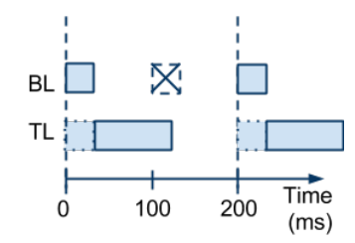
Warning: Timer overrun may still occur
BlinkLED
WCET: 30 ms
Period: 100 ms
Executions: 2
ThreeLEDs
WCET: 90 ms
Period: 200 ms
Executions: 1
Utilization = 75% < 100%

Slide 27
Are state machines actually parallel

Slide 28
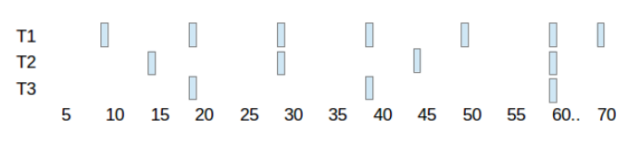
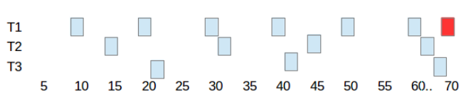
Recall the timing diagrams:

Slide 29
Recall the timing diagrams:
What is happening here?
And here?

Slide 30
Jitter
The jitter is the time between when a task is ready to execute, and when it starts executing
BlinkLED
WCET: 30 ms
Period: 500 ms
ThreeLEDs
WCET: 90 ms
Period: 500 ms
TL experiences 30 ms of jitter while BL executes

Slide 31
Jitter
Jitter affects some tasks more than others
Imagine a task that blinks an LED every 50 ms
A jitter of 10 ms can mean it now blinks every 60 ms
Tasks that display something are typically more affected
Tasks that simply perform calculations are less likely to be affected

Slide 32
How do we consider timer overrun and jitter when executing tasks?
Notes:
Let the students puzzle through this

